Slide 1


Slide 2
There ain’t no 911 on Mars

Slide 3
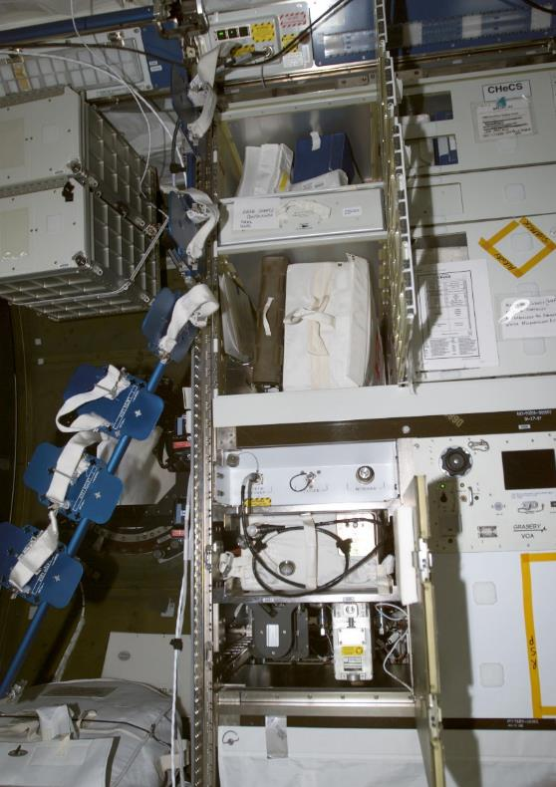
Current astromed
66 x 35.6 x 20.3 cm
(26.0" x 14.0" x 8.0")
16.34kg (36.0lbs)

Slide 4
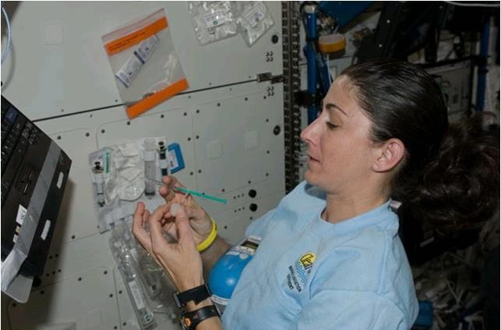
Problem x2
Medical Devices
Medical Storage Case(s)

Slide 5
Problem x2
Medical Devices
Single use
Single purpose
Not recyclable
What you take is what you have
Don’t follow current medical best practices
Medical Storage Case(s)
Very bulky/large
Single purpose
Lots of little compartments
Float away in low/or zero-g
Not ergonomic
Non optimal packing

Slide 6
3D Printing (In space)!
Can create or replace many devices
Recycle many devices by re-melting
Built-in sterilization (high-heat)
Standardization of common tools and handles
Significant weight and packaging advantages
Create new or modify existing devices for the environment

Slide 7
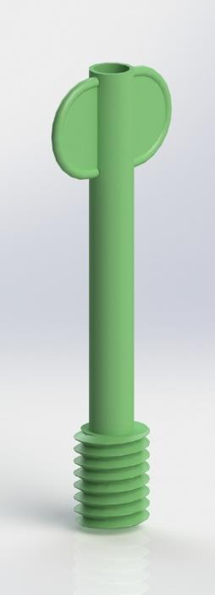
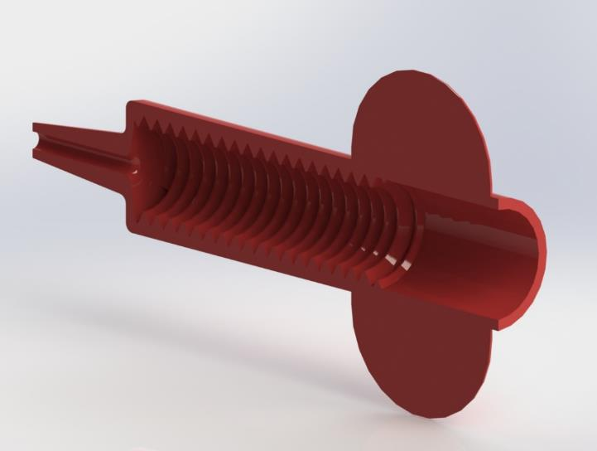
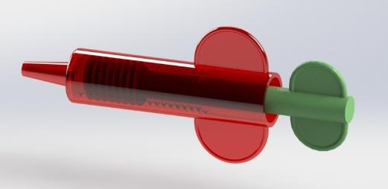
Novel syringe for 0g

Slide 8
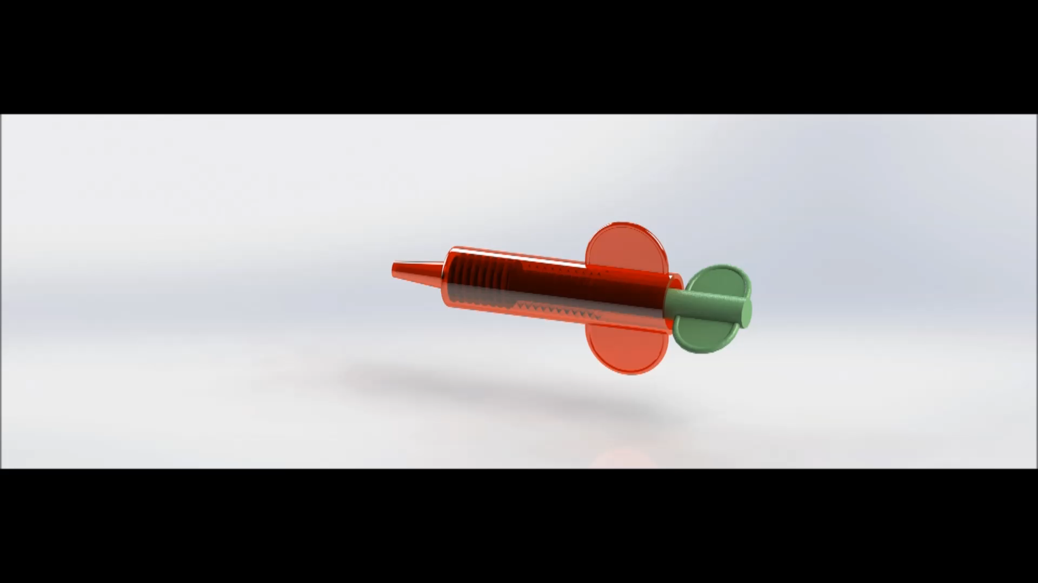
Novel syringe for 0g

Slide 9
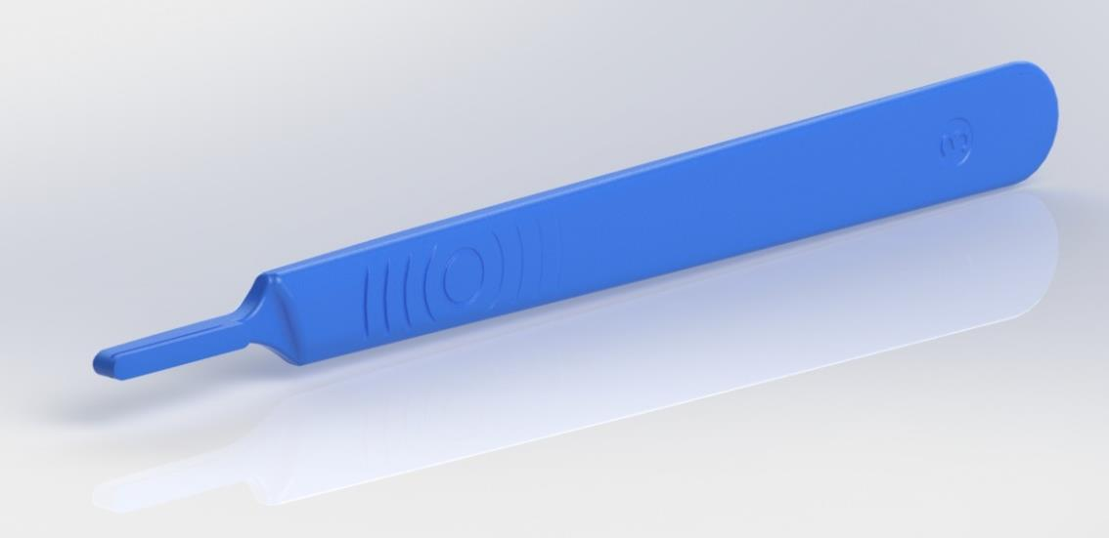
Scalpel handle

Slide 10
Short list of candidate devices
Syringe (3cc, 5cc, 10cc, 20cc)
Magill Forceps
Suction Syringe
Luer Lock
Tongue Depressors
Bandage Scissors
IV Flow Meter
Splints
Dental Probes
Reflex hammer
Capillary Bulb
Tubex Injector
Forceps
Hemostats
Needle Driver
Nasal Speculm
Finger Splint
SAM Splint
*All based off of the NASA International Space Station Medical Hardware Catalog, CHeCS v10.0

Slide 11
Additional Suggested kit items
Based on battlefield, EMS, ER, ICU, and OR experiences
Single person trauma kits (aka Israeli bandages)
Single person hydration and electrolyte mixes
UV Sterilization Kit
Instant blood clotting kits
Bone Vascular Access System (aka Bone IV)

Slide 12
Packing for spacetravel
Metal, Ceramic, and Starter Kits + 3D Base Material
3D material high-temp heater and recycler
Multi-use packaging
Example: Every scalpel blade wrapped in sterile gauze or bandage
Our optimized flip-open / origami packaging

Slide 13
Packing and Storing
Optimize packing and storage of individual medical kits
Easy access to kits, while providing tight packing
Provide a multi-use packing box that can itself be made into a bandage
Easy to secure via Velcro to prevent floating away of instruments

Slide 14
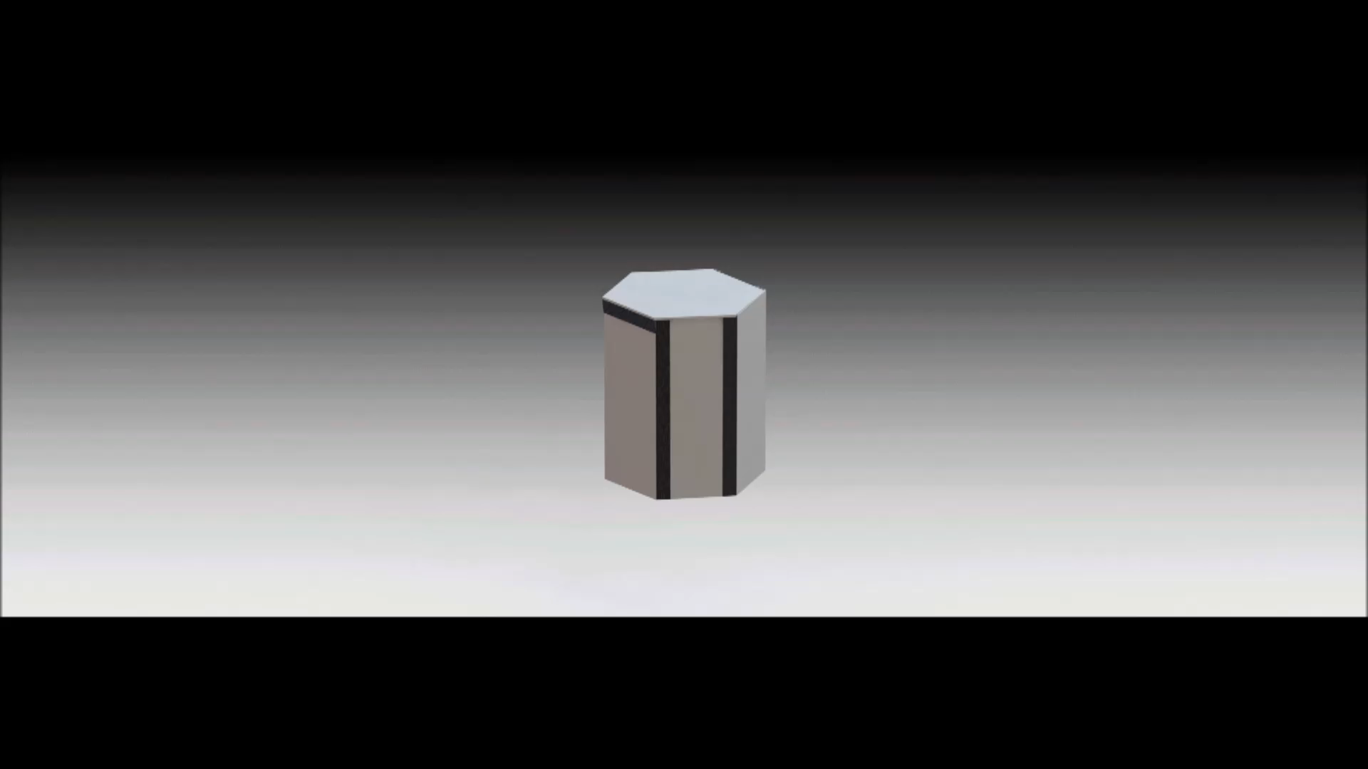
Origami Storage + medical Devices

Slide 15
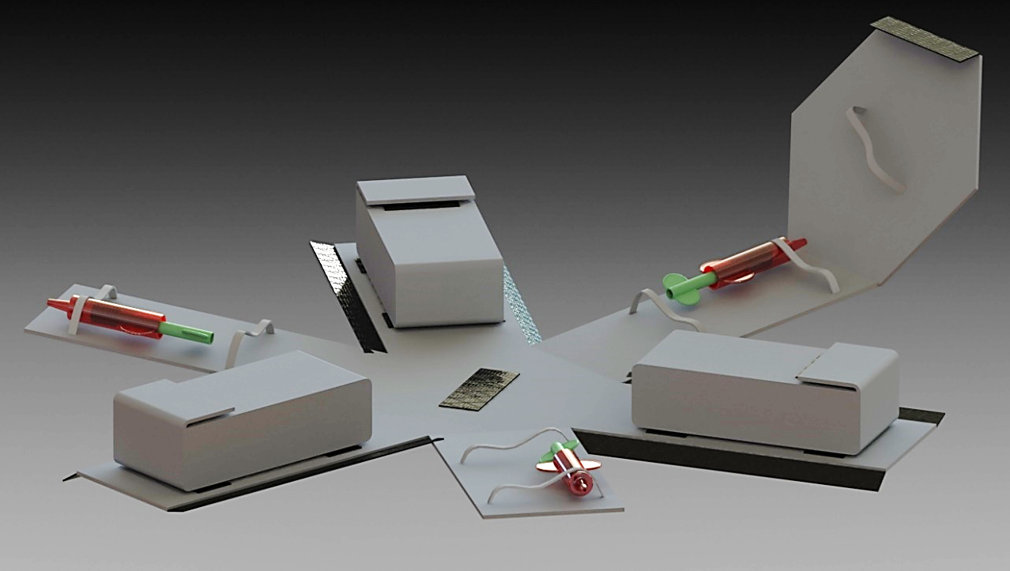
Origami Storage

Slide 16

Team Rocket Medicine
Eugene Malinskiy
Ilya Malinskiy
Daniel Dudley
Steve Mieskoski
Justin Nolan
(aka #spacenerds)
http://github.com/dragonid/nasa3dmeddevice2015

